Slide 1
EDA Capstone Project EDA on AIRBnB NYC
INDIVIDUAL PROJECT :-
Name :
Rohit Bodkhe

Slide 2



Slide 3
AIRBnB business highlights
Airbnb is an online marketplace that connects people who want to rent out their homes with people who are looking for accommodations in specific locales.
Airbnb offers people an easy, relatively stress-free way to earn some income from their property.
Guests often find Airbnb is cheaper, has more character, and is homier than hotels.
Airbnb makes the bulk of its revenue by charging a service fee for each booking.
Cons of using this service include not getting what you expected, and, for hosts, renting your place to someone you haven’t had the chance to meet first.

Slide 4
About
For this project we have analize Airbnb’s New York City (NYC) data of 2019. NYC is not only the most famous city in the world but also one of the top destination ofr the visitors for its museums, resturants, entertainment, etc.
Our main objective is to find the key points of the influence the listing of properties on that platform. First we will explore and visualize the dataset from Airbnb NYC and will perform the basic EDA (exploratory data analysis) techniques.
Data analysis of thousands of listings provided by Airbnb is crucial factor for the company
We will find out the distribution of Airbnb listings based on their location the NYC which will include the location, room type, price range and other related factors

Slide 5
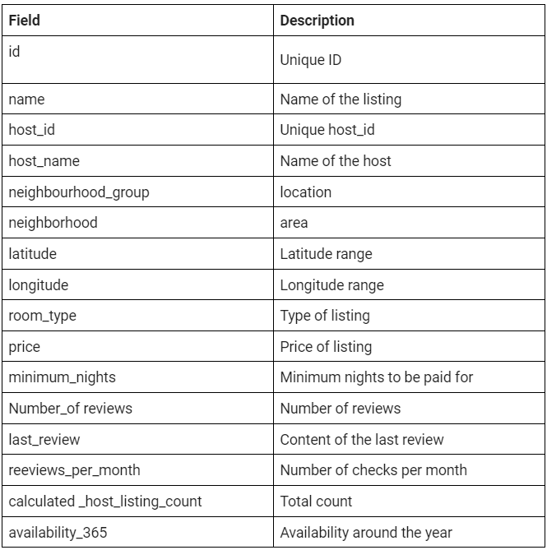
Understanding of given data

Slide 6
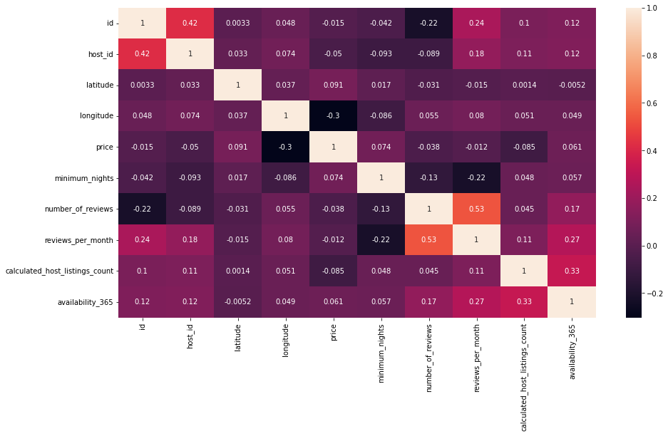
Correlation
There is not a strong correlation except review_per_month and number_of_review.

Slide 7
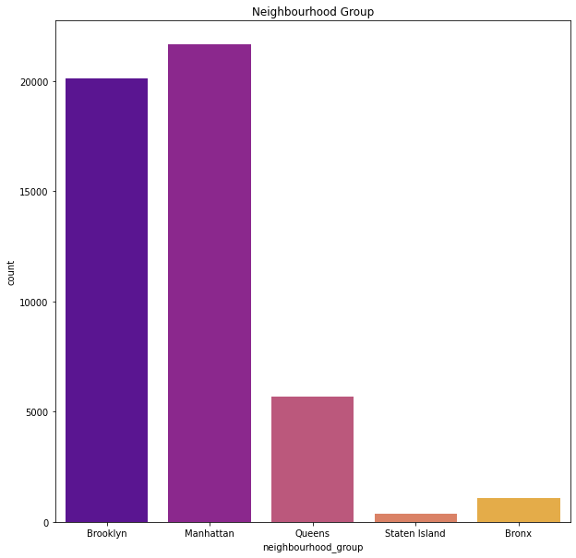
Various Neighbourhood Group and its Listing Insights
Manhattan has the highest number of listing followed by Brooklyn
State Island stands at the lowest number of listing for less than 1%

Slide 8
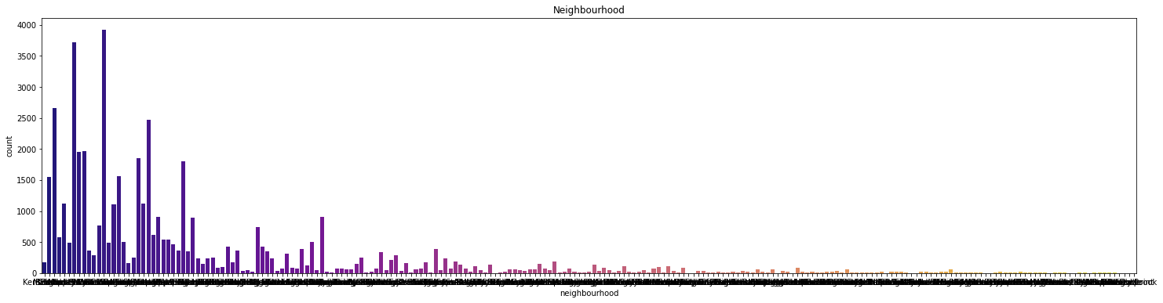
Neighbourhood Indepth
Total count of all the Neighbourhood Cities.

Slide 9
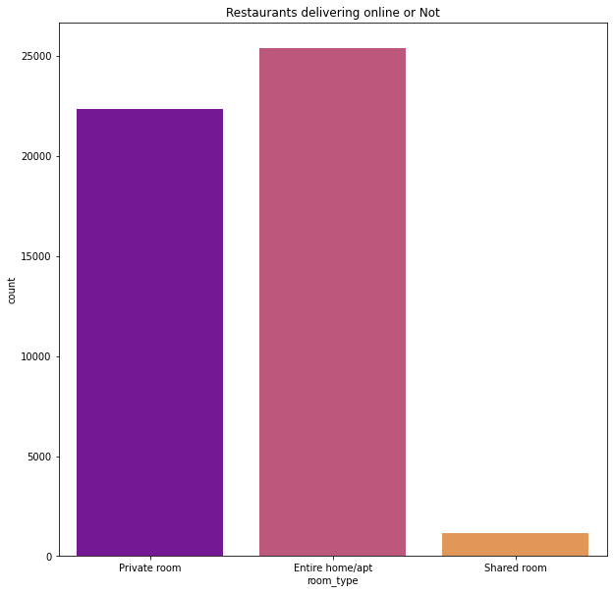
Online Food Delivering Status
Entire home or apartment rooms type have the highest number of Restaurants delivering the food online to the property.
Its is then followed by the private rooms where online food is being delivered.
Shared rooms have the negligible number of resturants as compared to the other two in the status of online food delivering.

Slide 10
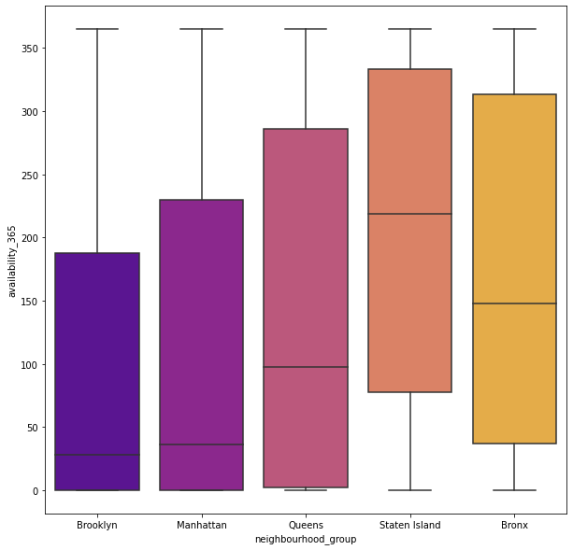
Average Approximate Availiablity
Maximum availability of the rooms on an average value is of State Island and Bronx.
Brooklyn and Manhattan Have the highest number of bookings all over the year and have the least number of availiablity of rooms across the year when compared with the neighbourhood group.

Slide 11
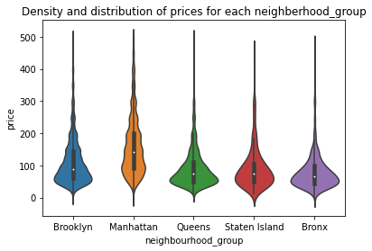
Density and Distribution of prices for each Neighbourhood group
With a statistical table and a violin plot we can definitely observe a couple of things about distribution of prices for Airbnb in NYC boroughs.
Manhattan has the highest range of prices for the listings with $150 price as average observation, followed by Brooklyn with \$90 per night.
Queens and Staten Island appear to have very similar distributions, Bronx is the cheapest of them all.

Slide 12
Conclusion
This Airbnb (‘AIRBNB_2019.CSV') dataset for the 2019 year appeared to be a very rich dataset with a variety of columns that allowed us to do deep data exploration on each significant column presented.
First, we have found hosts that take good advantage of the Airbnb platform and provide the most listings; we found that our top host has 327 listings.
After that, we proceeded with analyzing boroughs and neighborhood listing densities and what areas were more popular than another.
Next, we put good use of our latitude and longitude columns and used to create a geographical heatmap color-coded by the price of listings

Slide 13
Conclusion
Further, we came back to the first column with name strings and had to do a bit more coding to parse each title and analyze existing trends on how listings are named as well as what was the count for the most used words by hosts.
Lastly, we found the most reviewed listings and analyzed some additional attributes.
For our data exploration purposes, it also would be nice to have couple additional features, such as positive and negative numeric (0-5 stars) reviews or 0-5 star average review for each listing; addition of these features would help to determine the best-reviewed hosts for NYC along with 'number_of_review' column that is provided.

Slide 14
Conclusion
Overall, we discovered a very good number of interesting relationships between features and explained each step of the process.
This data analytics is very much mimicked on a higher level on Airbnb Data/Machine Learning team for better business decisions, control over the platform, marketing initiatives, implementation of new features and much more. Therefore, I hope this kernel helps everyone!

